Slide 1

The Pattern: Machine Learning Natural Language Processing meets VR/AR
Deploy large NLP models, create knowledge graph and build new types of interfaces.
Dr Alexander Mikhalev
Geek in Data Architecture team in Nationwide Building Society
Dvir Dukhan
SW Engineer - Redis Labs - CTO office
EUROPYTHON 2021

Slide 2
Agenda
We are not going to talk about VR/AR part because it’s Javascript (See talk from RedisConf 2021)
Introduction into Redis, Redis AI and Redis Gears
Overview of simple NLP pipeline in RedisGears
Deep dive into pipeline: BERT Question/Answering NLP Pipeline with Redis AI
Q&A Continues using Open Table (Silly Walks Room)

Slide 3

Dr Alexander Mikhalev
Geek in Data Architecture team in Nationwide Building Society
Passionate researcher and developer, ready to dive into new technologies and developing new things. I have a wide and diverse set of knowledge ranging from natural language processing to wireless and wired networks. I have a systematic approach to innovation and the ability to solve complex problems, for example in 2018 I run a "skunkworks lab" inside Nationwide Building Society which resulted in the first patent in the history of society on the topic of secure distribution of data. Current focus on synthetic data, data privacy and digital twins.

Slide 4

Dvir Dukhan
Software engineer for Redis Labs since 2019
Redis Labs ML/AI projects
RedisGraph
MSc - Computer Science - Technion

Slide 5
The Problem
The medical profession put a lot of effort into collaboration, starting from Latin as a common language to industry-wide thesauruses like UMLS. With a number of publications about COVID (SARS-V) passing 300+ per day, we need better tools to navigate via such flow of information.
The Pattern
To fight ever-increasing complexity, "The Pattern" projects help community to find relevant knowledge using Artificial Intelligence and novel UX elements, all powered by Redis - new generation real time data fabric turned into knowledge fabric. Work with information should not be limited to 2D and we are looking for “things not strings” only using Redis and Redis Modules
Notes:
vision which I have been thinking about for a while: . . "Engelbart’s demo": augmenting human intelligence using modern AI and VR tools, demonstrating new concepts to assist knowledge exploration, presentation and re-use.

Slide 6
Demo
http://thepattern.digital

Slide 7
What is Redis? https://redis.io
REmote DIctionary Server (Redis) is an open source (BSD licensed), in-memory data structure store, used as a database, cache and message broker. It supports data structures such as strings, hashes, lists, sets, sorted sets with range queries, bitmaps, hyperloglogs, geospatial indexes with radius queries and streams.

Slide 8
Redis Commands - Key and Values
127.0.0.1:6379> set key value
OK
127.0.0.1:6379> get key
"value"

Slide 9
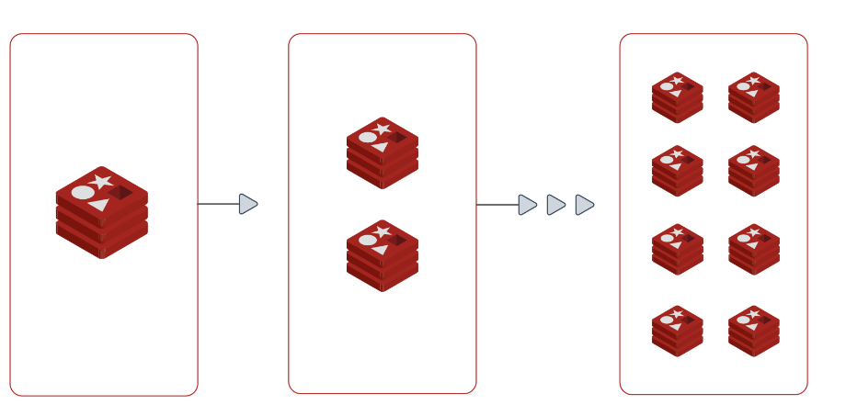
Scaling up/out by data sharding
Redis cluster splits the shard ownership of keys according to
HASH_SLOT = CRC16(key) mod 16384
And each shard is responsible for specific (continuous) range of hash slots
> CLUSTER KEYSLOT somekey
11058
> CLUSTER KEYSLOT foo{hash_tag}
(integer) 2515
> CLUSTER KEYSLOT bar{hash_tag}
(integer) 2515
0-8191
0-16383
8192-16383

Slide 10
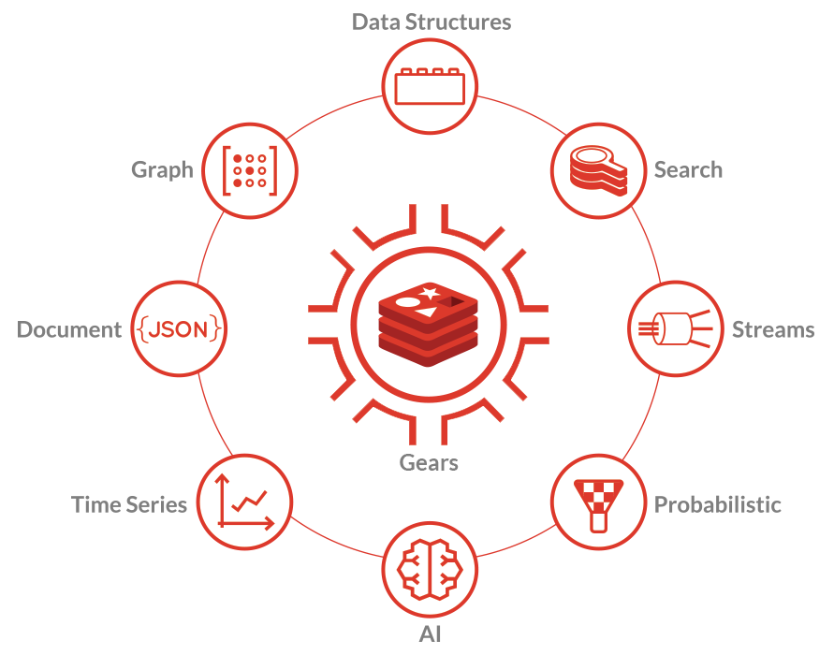
What are Redis modules?
Redis modules make it possible to extend Redis functionality using external modules, rapidly implementing new Redis commands with features similar to what can be done inside the core itself.

Slide 11

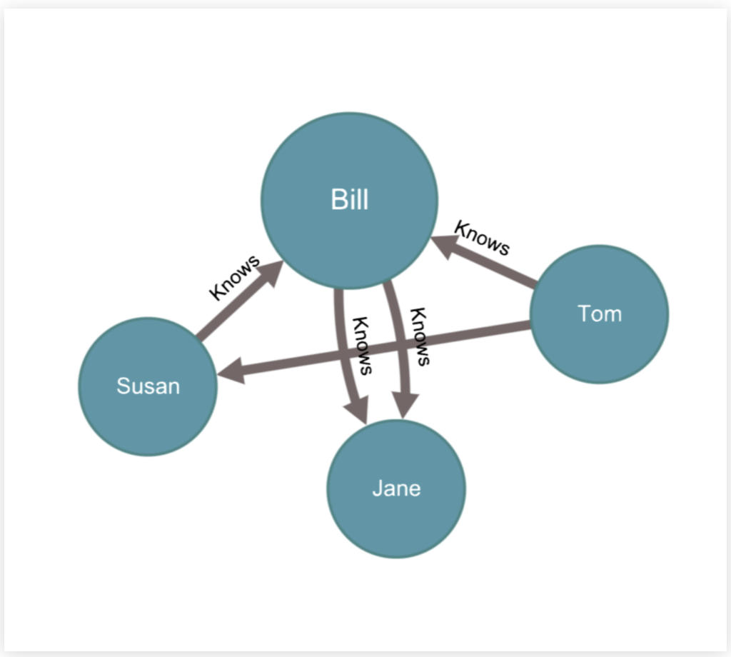
RedisGraph
Property graph database - entities are nodes and relationships. Each entity has its own properties
Open Cypher query language
MATCH p = (p1:Person {name: "Tom" })-[:Knows*1..3]-(p2:Person {name: "Jane"}) RETURN p
Using GraphBLAS - Linear algebra for sparse matrices
Redis Module

Slide 12


RedisAI
A Redis module providing
Tensors as a data type
and Deep Learning model execution
on CPU and GPU
It turns Redis into a full-fledged deep learning runtime While still being Redis

Slide 13




RedisAI
New data type:
CPU
GPU0
GPU1
…
Tensor
def addsq(a, b):
return (a + b)**2
TorchScript

Slide 14
What is RedisGears?
RedisGears is a Serverless engine for multi-model and cluster operations in Redis, supporting both event driven as well as batch operations
Agnostic from redis topology (stand alone, cluster, enterprise)
Built in coordinator for cluster support
Built in map/reduce operations
Sharding of data if on cluster
Automatic distribution of dependencies
Support full Python and C api
Built as a Redis module

Slide 15


RedisGears Architecture
More language Integrations to come...
User API
C API
Base API
Cluster Management
Execution Management
Map/Reduce
Core

Slide 16
Why use RedisGears for data scientists?
RedisGears have enormous potential, particularly for text processing - you can process your data “on data” without need to move them in and out of memory, summary of the important points:
In Memory storage (Horizontally scalable if it’s Redis cluster)
With data sharding
Processing of data (on data) without need to move in and out
Gears - like Spark on Hadoop, process data intelligently in-memory
Redis in cluster mode with RedisGears and python-enabled takes 20 MB RAM.
Think how much more data you can shuffle into your laptop or server.

Slide 17


Turn Text into Knowledge Graph
using Aho-Corasick matcher

Slide 18
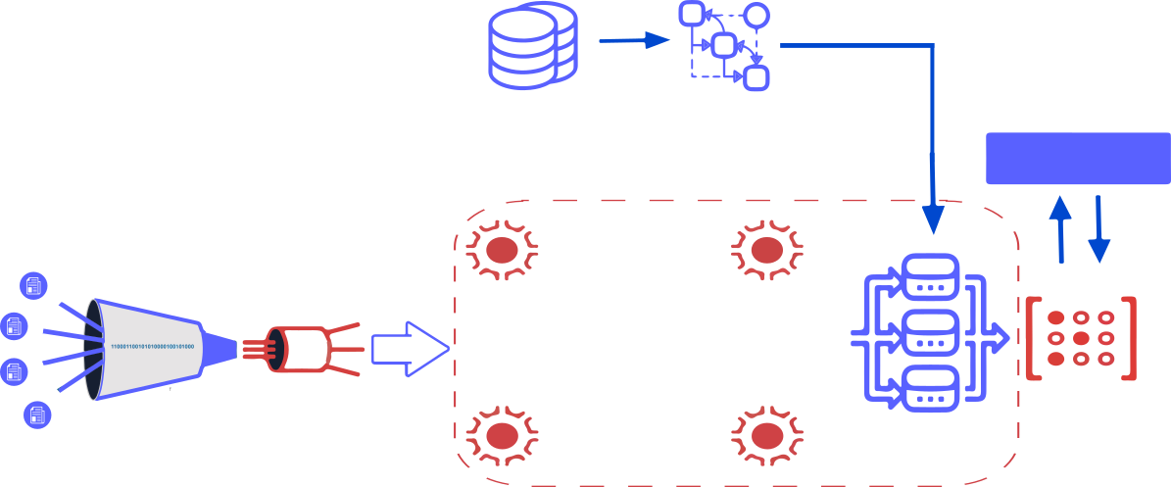
First pipeline: Turn Text into Knowledge Graph
Read UMLS table
Build automata
Flask API
Extract & parse cord-19 documents
Create streams
Language
detector
Spell
checker
Split
paragraphs
Redis Graph
Matcher
Redis Gears
Notes:
Why do you need RedisGears based pipeline? While 50 thousands articles is a small dataset by modern standard, it’s more than single laptop can handle. Redis Gears provides a very easy way to create a distributed data processing. We will be re-using half of the pipeline - until matcher step, but then we fork and adjust pipeline to use Redis AI

Slide 19

BERT Introduction
BERT (Bidirectional Encoder Representations from Transformers)
Created by researchers at Google AI Language
State-of-the-art results in a wide variety of NLP tasks, including Question Answering (SQuAD v1.1), Natural Language Inference (MNLI), and others.
Use cases
Next Sentence Prediction
Text Summarization
Question Answering
Text classification and many more
Read more about BERT at Towards Data Science blog

Slide 20
Summary: See Pipeline 3
Query processing
Search Phrase
Aho-Corasick Matcher:
turn text into nodes
RedisGraph:
nodes and edges
Redis: List of titles and edges
Flask API
We are fetching key if key is not present NLP pipeline 2 is triggered to calculate answer.
BERT QA ML models and potentials answers are preloaded on each shard
Answer: See Pipeline 2

Slide 21
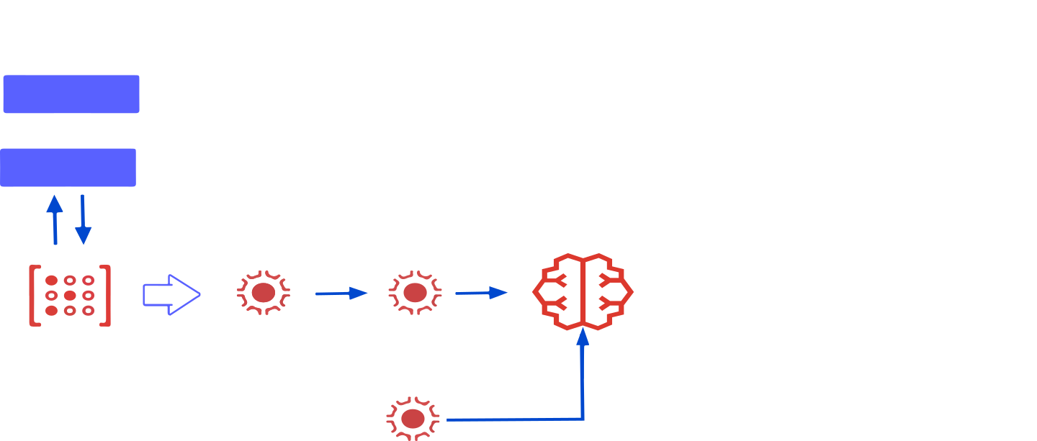
BERT Question/Answering NLP Pipeline with Redis AI
Question
Flask API
Keymiss event
Tokenize and append to potential answers
Run: BERT QA inference
Answer: stored on Redis shard
RedisGears: tokenize potential answers
Notes:
The purpose of keymiss event: if answer is not in cache, we are generating answer and saving it for future use. We are fetching key if key are not there whole NLP pipeline 2 is trigger.

Slide 22
The Most Advanced code in NLP pipeline:
try:
from rediscluster import RedisCluster
redisai_cluster_client = RedisCluster(startup_nodes=startup_nodes, decode_responses=True)
except:
print("Redis Cluster is not available")
def qa(question, sentence_key,hash_tag):
### get "bertqa{06S}_PMC7167827.xml:{06S}:11_When wheezing were recorded?"
query_key=f"bertqa{hash_tag}_{sentence_key}_{question}"
print("Query key " + query_key)
answer=redisai_cluster_client.get(query_key)
return answer
if __name__ == "__main__":
question="When wheezing were recorded?"
print(qa(question,"PMC261870.xml:{06S}:11",'{06S}'))

Slide 23
Code (better follow link)
Most advanced code is in the-pattern-api/qasearch/qa_bert.py querying RedisGears+RedisAI cluster given user's question:
get "bertqa{5M5}_PMC140314.xml:{5M5}:44_When air samples collected?"
this queries bertqa prefix on shard {5MP} where PMC140314.xml:{5M5}:44 is the key of pre-tokenised REDIS AI Tensor (potential answer) and "When air samples collected?" is the question from the user.
Redis Gears captures keymiss event the-pattern-api/qasearch/qa_redisai_gear_map_keymiss_np.py:
gb = GB('KeysReader')
gb.map(qa_cached_keymiss)
gb.register(prefix='bertqa*', commands=['get'], eventTypes=['keymiss'], mode="async_local")
and runs:
redisAI.getTensorFromKey
redisAI.createModelRunner
redisAI.createTensorFromBlob
redisAI.modelRunnerAddInput
redisAI.modelRunnerRunAsync in async/await - non-blocking main thread mode.
BERT QA models pre-loaded on each shard using AI.modelset in the-pattern-api/qasearch/export_load_bert.py.
It will cache user’s response so hitting the same API twice will return answer in nanoseconds

Slide 24
Code (better follow link)
async def qa_cached_keymiss(record):
val=record['key'].split('_')
cache_key='bertqa{%s}_%s_%s' % (hashtag(), val[1],val[2])
log("QA cached called from keymiss")
res = await qa(val)
log("Result "+str(res))
log("Cache key "+str(cache_key))
execute('set',cache_key, res)
override_reply(res)
return res

Slide 25
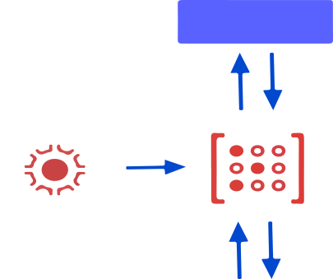
Google T5: the Text-To-Text Transfer Transformer model for summarization
Flask API
Tokenize text and truncate to 512 tokens
Store queue in Redis Set
Run T5 inference on instance with GPU

Slide 26
Join us and contribute
Overall Github repository The Pattern
Live demo server
Join our team on Discord
5 minute introduction video from RedisHackathon 2021
RedisConf 2021 conference talk video
"Building a Pipeline for Natural Language Processing using RedisGears" on the RedisLabs developers website describing Pipeline 1 details

Slide 27
Q&A

Slide 28
Why do you need roles? Unsolved Challenge of Relevance
But “bleeding” means 11000 different things in Medical Dictionary (UMLS)
Assuming General Practitioner or Nurse interested in
- Anatomical Structure
- Disease or Syndrome
- Body Part, Organ, or Organ Component
- Diagnostic Procedure
we can limit Knowledge Graph output only to concepts found in those (semantic) layers
Notes:
vision which I have been thinking about for a while: work with information should not be limited to 2D and we are looking for “things not strings”. Using Redis technologies whenever possible.

Slide 29
Knowledge Graph, Graph Database and querying graph
Knowledge graphs (Paper) | Graph Databases (brick) | GraphQL/RDF/REST/SPARQL (Orange)
What to write (things not strings) | Where to write and read from | How to query

Slide 30
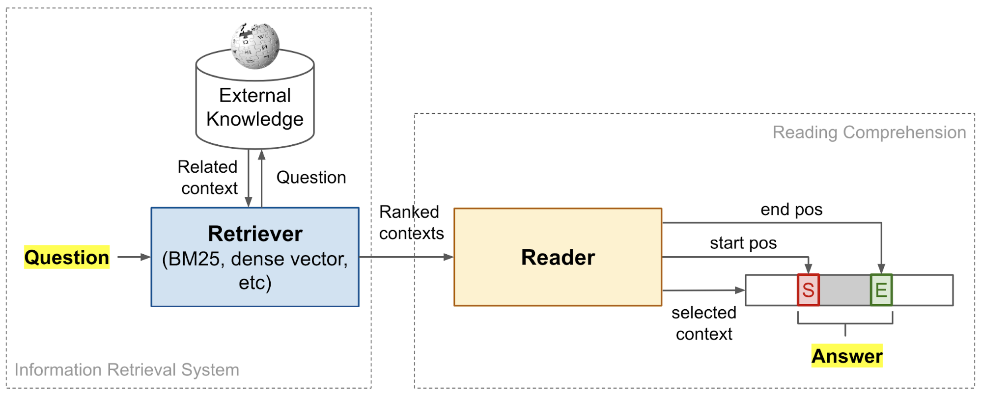
Open Domain Question Answering
Open Domain Question/Answering

